Slide 1
Web Graphics
Web Graphics
Adobe Stock
Notes:
Photo of 3 screen sizes responsive design
a good example of how content should scale across screens. Easy to read

Slide 2
Website Graphics
2.0 Website Graphics
2.4 Recognize when images will need to be scaled/resized.
2.5 Compare the different methods of resizing images.
2.6 Discuss the various graphic formats currently in use.
2.7 Give examples of when specific graphic formats are used.

Slide 3
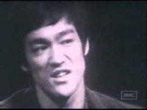
Make content like water so it can flow and have scalability
https://youtu.be/cJMwBwFj5nQ
Bruce Lee “Be Water My Friend”

Slide 4
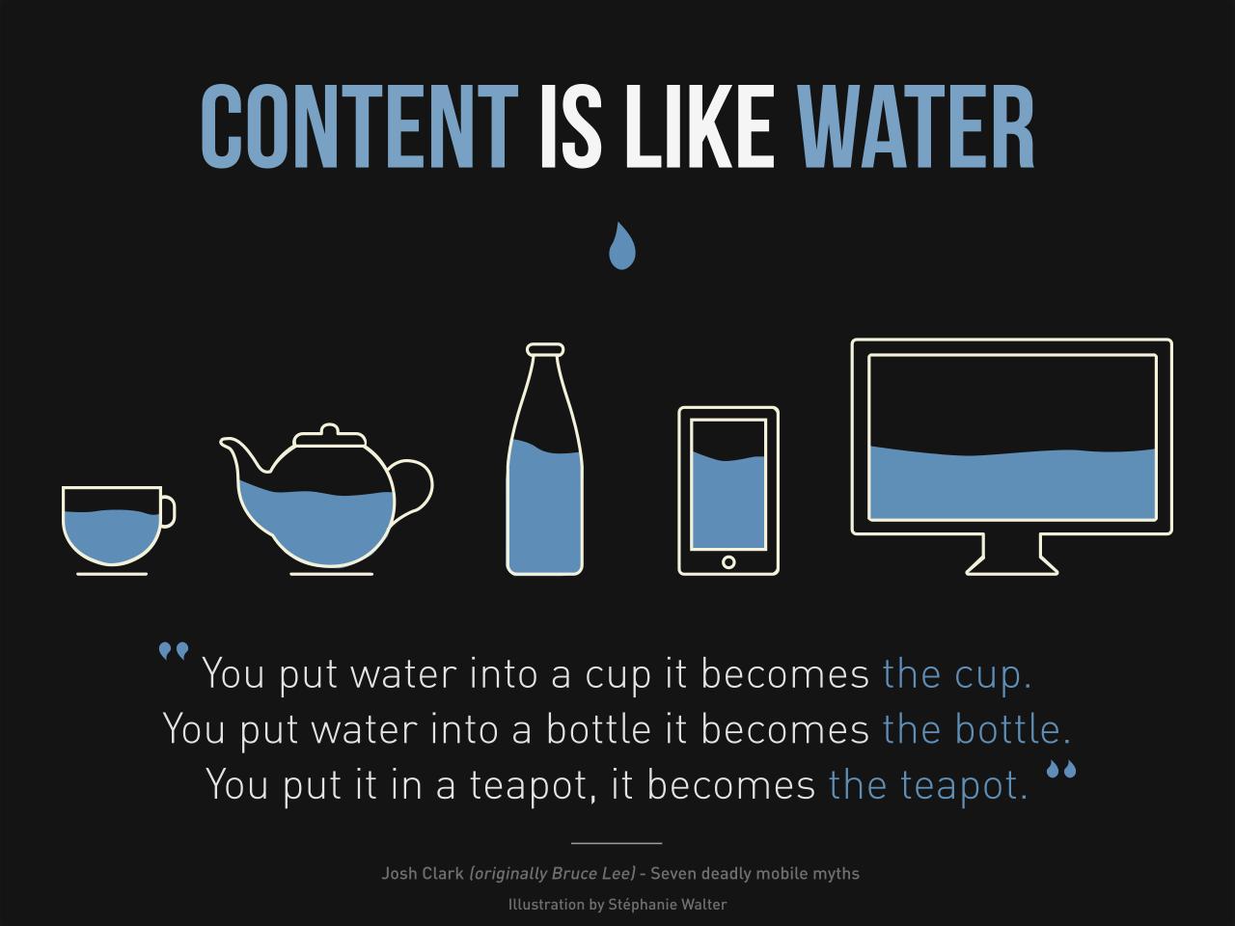
Content is like water…
This GRAPHIC depicts the concept of web content and how it all needs to be scalable in Responsible Web Design (RSWD)
Content is like water "You put the water into a cup it becomes the cup. You put water into a bottle it becomes the the bottle. You put it in a teapot, it becomes the teapot."
Quote originally by Bruce Lee. Josh Clark an expert in the field of RWD uses it in an article Seven deadly mobile myths. Illustration iby Stéphanie Walter

Slide 5
Content is like water
Design must be able to adjust and mold to different screen sizes.
Illustrator can create graphics called SVG (Scalable Vector Graphics) are great for logos on web/apps
Images that are scalable are practical for responsive web design (RWD)
Not all images need to be scalable for example photos that are pixel based need to be looked at from a compositional standpoint, to see if the main feature of the composition will get viewed properly without cutting off important areas, (image safety needs to be used) to see knowing when to size and optimize is vital.

Slide 6
Website Graphics (cont’d)
Not all images (photo pixel images) can be scalable however, knowing how to size and optimize images for a variety of screens sizes is crucial to building an effective web design layout.
Let’s talk a look at graphic and photo file formats

Slide 7
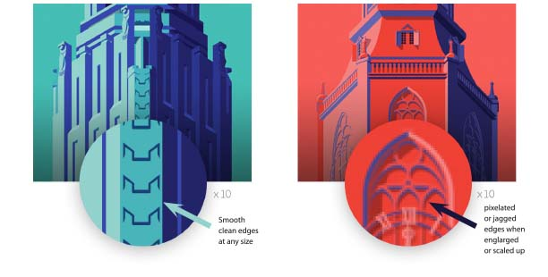
Types of graphics Vector VS Raster

Slide 8
Types of graphics Vector VS Raster (cont’d)
VECTOR ARTWORK
Vector images are resolution independent. When you shrink or enlarge a vector image, your shapes get larger, but you won’t lose any detail or get pixelated (the jagged edges). The image will always render identically, no matter the size, and is infinitely scalable
PROS - Scalable to any print output size. Vector graphics are often used for diagrams and logos. Small file size.
CONS - Can be easily rasterized for screen use

Slide 9
Types of graphics Vector VS Raster (cont’d, 2)
VECTOR ARTWORK
Vector images are resolution independent. When you shrink or enlarge a vector image, your shapes get larger, but will not lose any detail or get any pixilation (the jagged edges). Because your image will always render identically, no matter the size. A scalable file type
PROS - Scalable to any print output size. Vector graphics are always used for large signs, diagrams and logos.
And can be easily rasterized for screen use (bitmap use)

Slide 10
Types of graphics Vector (Scalable) Images
VECTOR Image File Formats
Vector files can be saved or edited in these formats:
.ai (Adobe Illustrator document)
.eps (Encapsulated PostScript)
.svg (Scalable Vector Graphic) WEB FILE FORMAT
.pdf (Portable Document Format; only when saved from vector programs)

Slide 11
Types of graphics
RASTER (Bitmaps ARTWORK
Any digital image, graphic or photographic that is formatted as a .jpg, png, or gif is a raster graphic made up of a mosaic like grid of pixels which represent a multitude of colours or continuous tone as in would be viewed in a photographic image.
PROS - For images that need to convey continuous tone and gradations of colour, and details, shading, and light to dark colours perfect for photographs.
CONS - Does not scale to a larger size well, losses quality and will have jagged edges. Can have large file sizes dependent of the number of pixels, and pixel density.

Slide 12
Types of graphics Raster (Bitmap) Images
RASTER Image File Formats
.tiff (Tagged Image File Format)
.psd (Adobe Photoshop Document)
.pdf (Portable Document Format)
.jpg (Joint Photographics Expert Group) WEB FILE FORMAT
.png (Portable Network Graphic) WEB FILE FORMAT
.gif (Graphics Interchange Format) WEB FILE FORMAT
.bmp (Bitmap Image File)

Slide 13
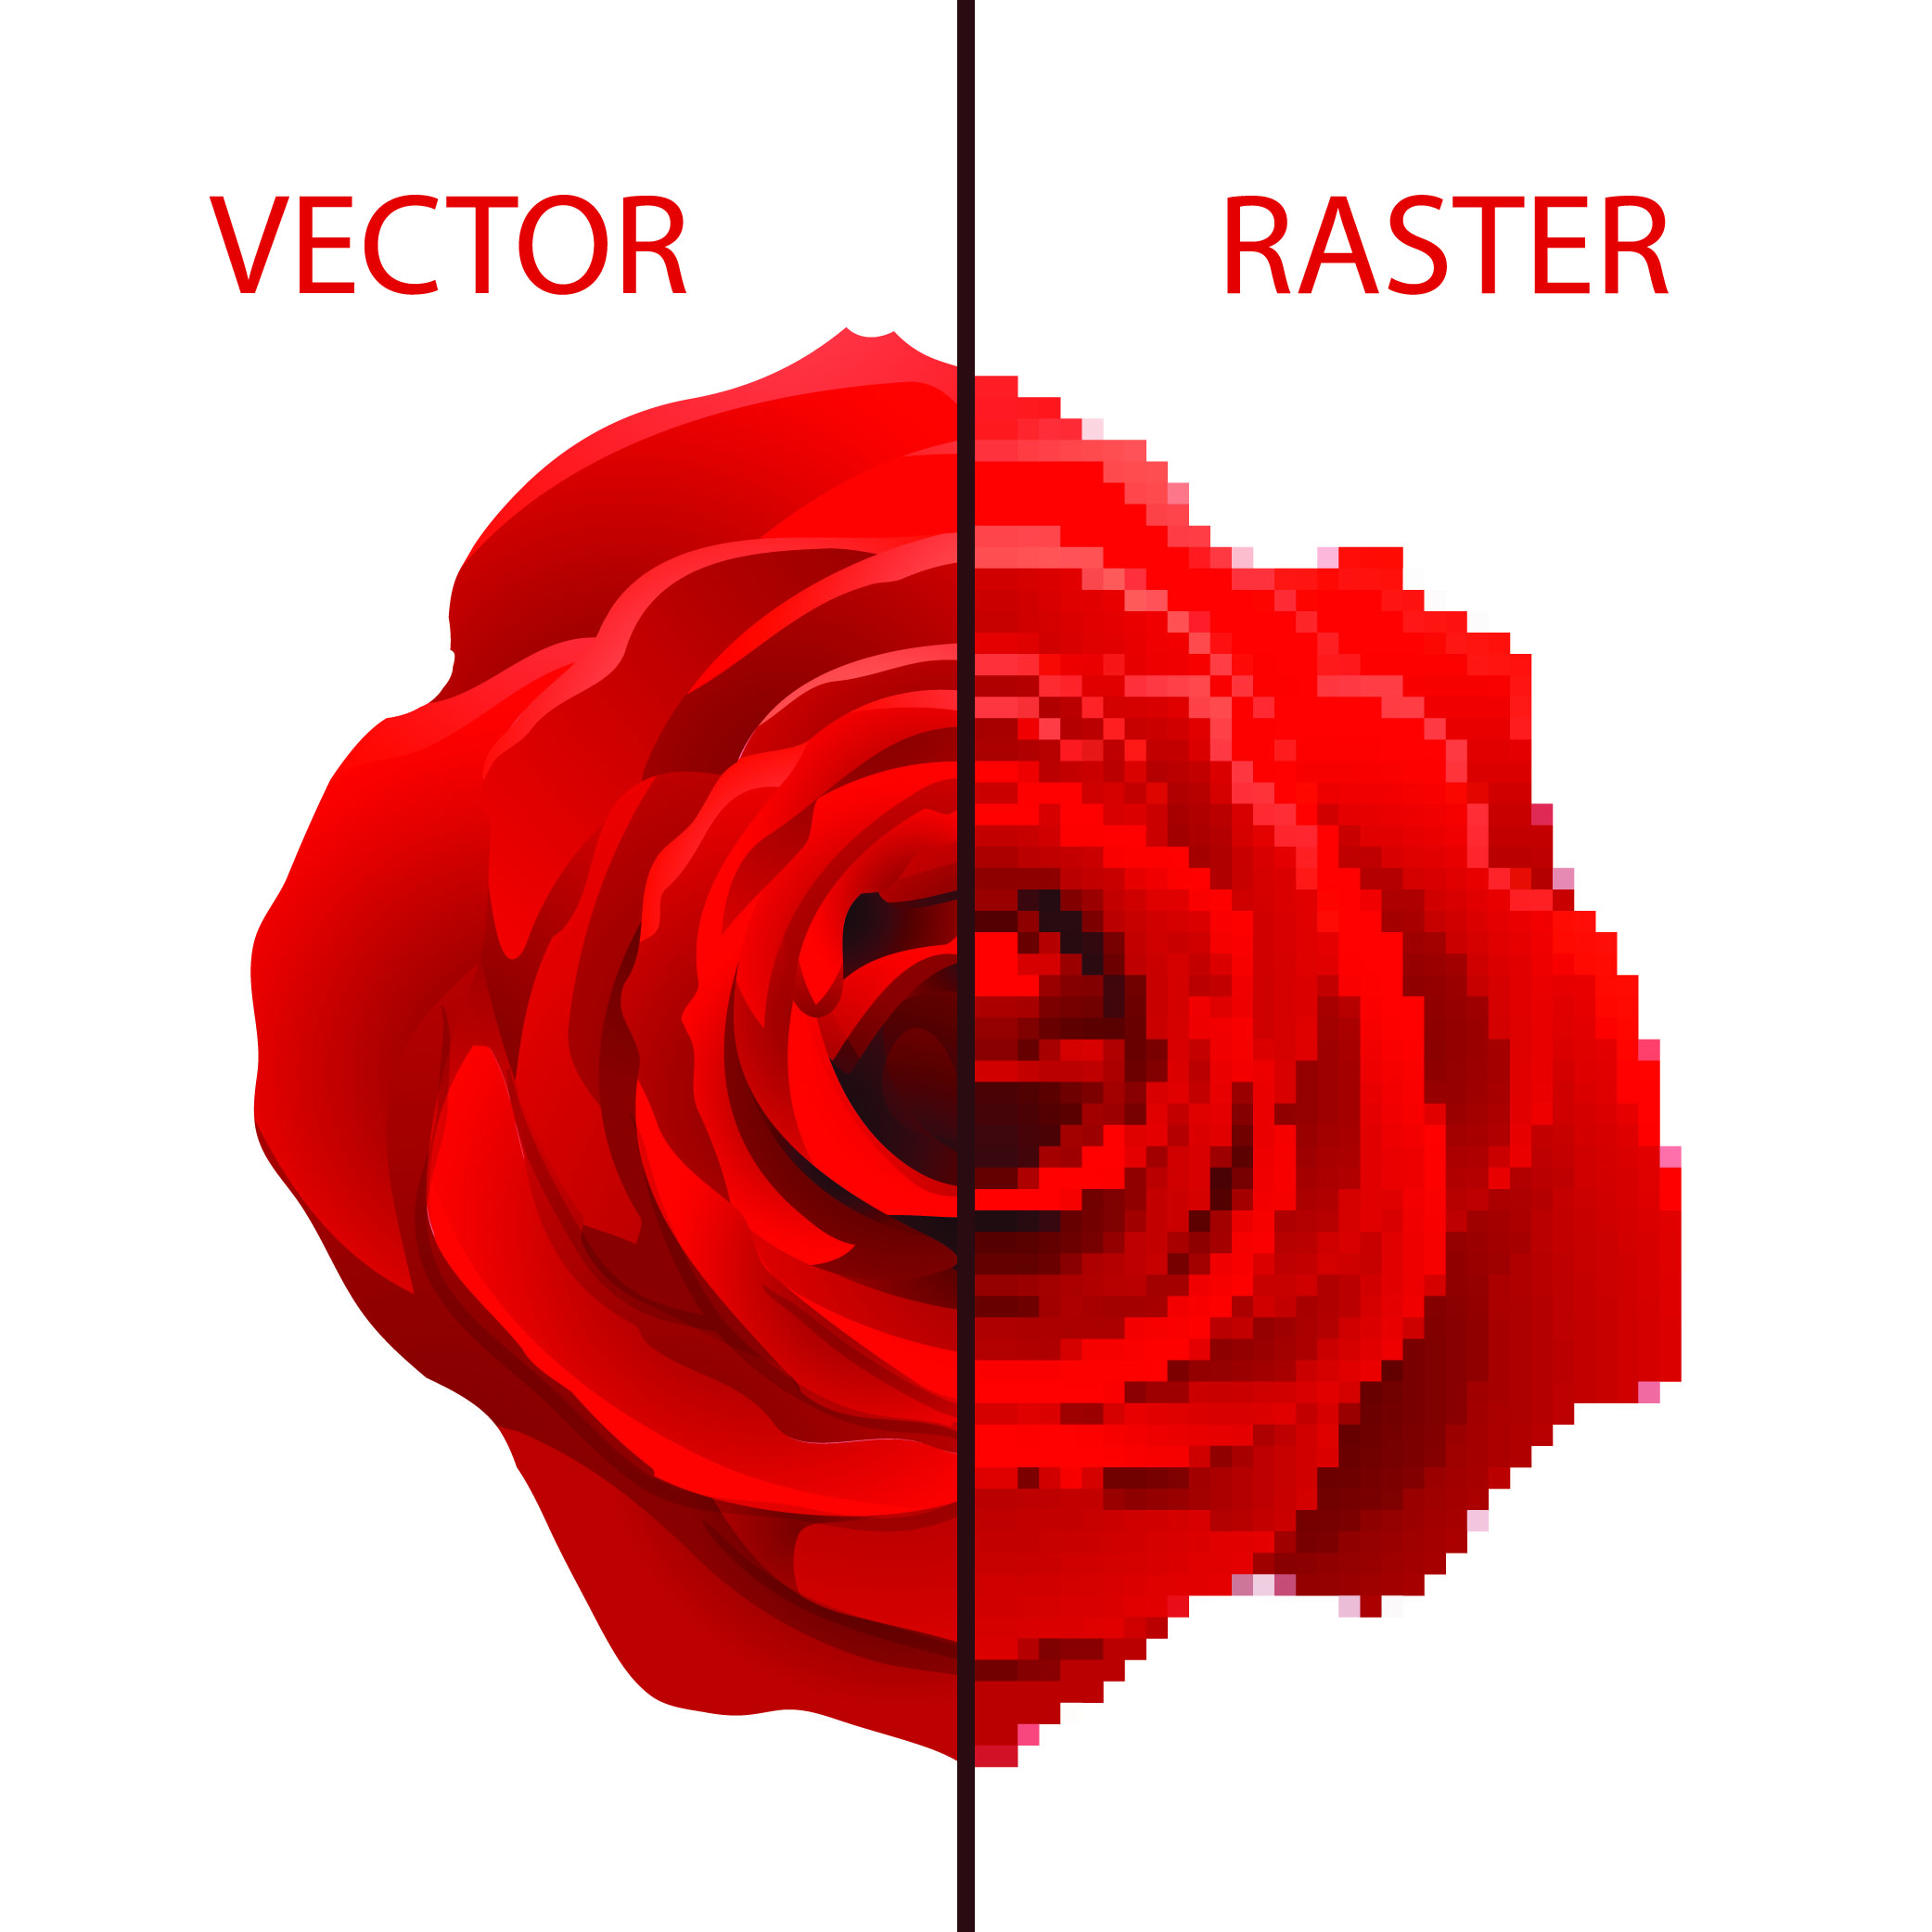
Vector vs Raster
Notes:
A picture of red rose showing the benefits of vector edges and and enlarger raster image with usndesirabe jagged edges.

